Slide 1

Final Project Your Topic Name
Your Last Name, Your First Name
CSCI E-63 Big Data Analytics
Harvard University Extension School
Prof. Zoran B. Djordjević

Slide 2
Introduction
Narrative

Slide 3
YouTube URLs, Last Page
Two minute (short):
15 minutes (long):

Slide 4
Installation Notes
Follow the instructions on: https://paradigm4.atlassian.net/wiki/display/ESD/SciDB+Community+Edition+Installation+Guide
The VM that has scidb installed provided by paradigm4 https://drive.google.com/drive/folders/0B7yt0n33Us0rT1FJdmxFV2g0OHc
has several problems:
The pre-installed scidb R package is severely outdated. Several functions documented in the package are not available.
There exists a problem with the system’s MPI library that would prevent us to perform many important linear algebra operations like gesvd().
Install scidb 15.12 on Ubuntu 14.04 from scratch.

Slide 5
Installation Notes
Ubuntu 14.04 download and set-up:
http://releases.ubuntu.com/14.04/
scidb installation requires passwords for both the root and scidb users on all the hosts. So the root login must be enabled on Ubuntu. This link explains the setup: https://askubuntu.com/questions/44418/how-to-enable-root-login
SSH public key
Following section “Providing Passwordless SSH” in the installation document
Copy the generated public key file id_rsa.pub in the /home/.ssh directory to the ./ssh directories of all the users living on the cluster of one or more hosts, and rename it as “authorized_keys”
In our case, 1 host 2 uses, “scidb” and “root”, so copy and rename id_rsa.pub to /home/.ssh and /root/.ssh.
The /.ssh directories are hidden by default in Ubuntu 14.04.

Slide 6
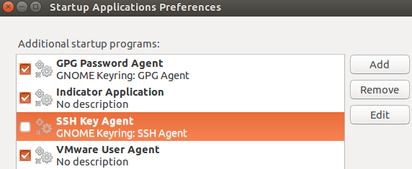
Installation Notes
“Agent admitted failure to sign using the key”
After deploying scidb access to the users, to confirm the connection, the above error could happen.
Cause: Ubuntu desktop system uses gnome-keyring, which doesn’t always handle specific formats of SSH keys correctly.
To confirm the cause, add SSH_AUTH_SOCK=0 in front of ssh connecting command, e.g.
SSH_AUTH_SOCK=0 ssh scidb@127.0.0.1
Solution: uncheck SSH key Agent in “Startup Applications Preferences”.

Slide 7
Installation Notes
Build from source, ./run.py make
Assign at least 8 GB memory to the VM. Several compiling steps need considerable amount of memory. If the memory is not enough, it runs into fatal errors.
Assign appropriate number of processors to the VM in order to compile the source code in parallel fashion, e.g. ./run.py make -j4 (4 threads)
Install R, Rstudio, R package scidb
Do not install the CRAN package scidb 2.0.0, which currently is not stable.
Install the package from github by devtools::install_github("Paradigm4/SciDBR")
To install devtools, first in terminal do
sudo apt-get install libcurl4-openssl-dev libssl-dev
In R terminal, execute install.packages("devtools")
Notes:
according to their vignette, the

Slide 8
Installation Notes
Install shim
shim is a simple SciDB client that exposes limited SciDB functionality through a simple HTTP API.
Will enable us to connect to localhost:8080 (if the host IP is set as 127.0.0.1) and submit iquery.
Will enable us to connect scidb in R.
Instruction site: https://github.com/Paradigm4/shim
Head to section “LD_LIBRARY_PATH issues” if a library linking error happens when trying to run shim
Notes:
according to their vignette, the

